Slide 1





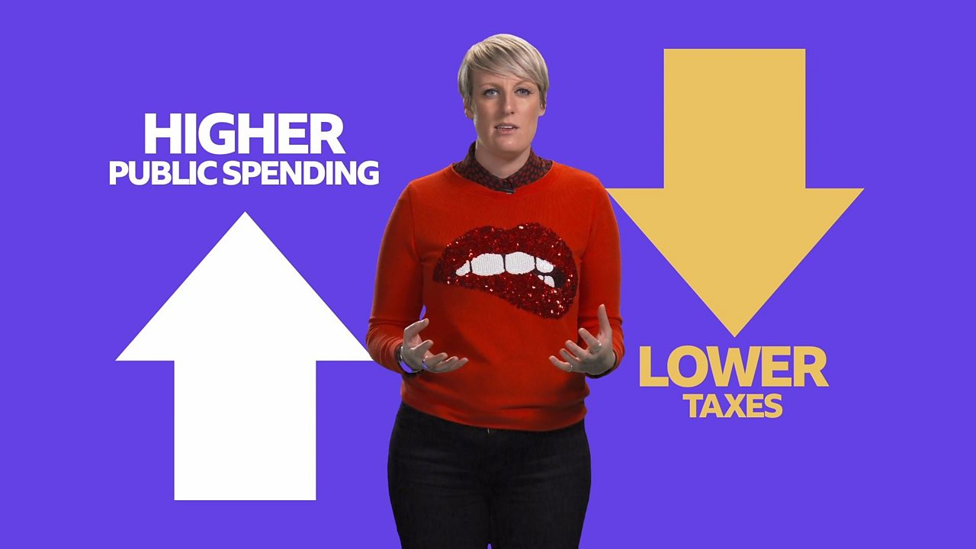

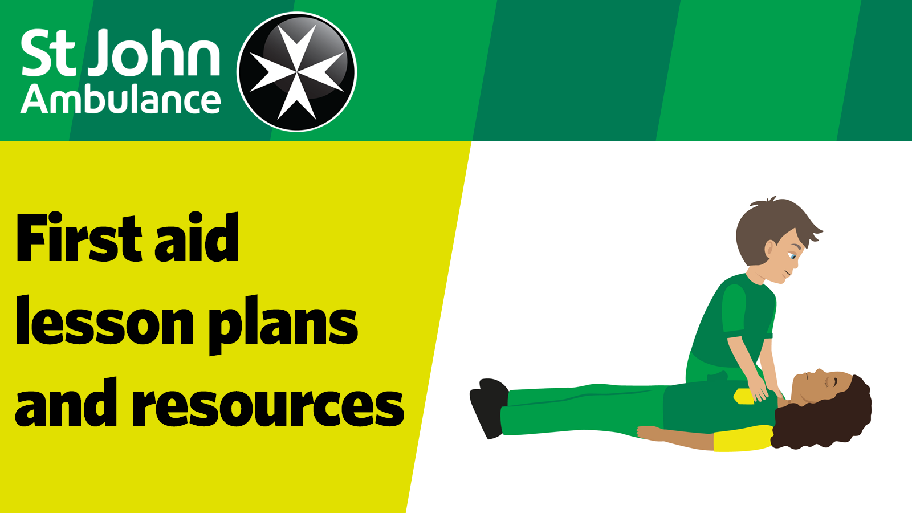
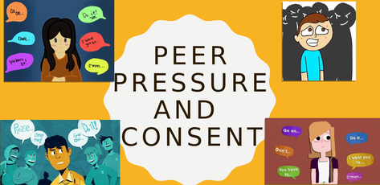



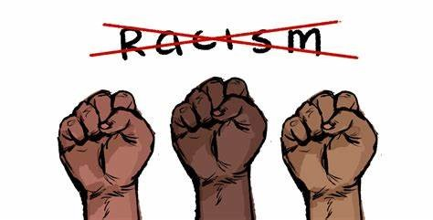
Beacon Hill Academy
Personal Development Programme
KS3 Learning Journey
County Lines
Law
Youth offenders
Avoiding debt
Knife crime
Sustainability
Personal Finance
Living In the wider world
Health and Well Being
Employability
Diversity
Careers
Self-harm
Anxiety
Substance Abuse
Alcohol
Conflict
Workplace skill
Stem cell
Blood
Mental health
Relationships
Domestic abuse
Personal safety
Organ
Drugs
LGBT+
Law
Acid attacks
Stress
Vaccination
Mindset
Eating Disorders
Living In the wider world
Prejudice
Welcome to Year 9
Relationships and Sex Educations and ESafety
Bullying
Finance
Careers
Gangs
Tax + saving
Discrimination LGBT
Predators
Body Images
Behaviour
Budgeting
Bullying
Peer Pressure
Vocational Qualities
Crime
Gangs
Child sexual exploitation
Disability
Parenting
Health and well being
Online predators
Pregnancy
Emotions
First aid
Domestic Conflict
Tolerance
Vaping
Mindfulness
Nicotine addiction
Cancer awareness
Self-awareness
Wellbeing
Body Image
Personal safety
Anti Racism
Extremism + radicalisation
Introduction to secondary school
British Values
Racism
Relationships and Sex Educations and ESafety
Sexual health
Aspiration
Resilient
Budgeting
Consent
Pornography
Sexting
Living In the wider world
Self Esteem
Finance
Stereotypes
Safe sex
Contraception
Image sharing
Online Safety
Welcome to Year 8
Depression
Introduction to addiction
Exercise
Healthy Living
Health and well being
Anger Management
Puberty + FGM
Smoking
Dangerous
Mental Health
Energy Drinks
Substances
Drugs
Healthy eating
Nutrition
Relationships and Sex Educations and ESafety
PSHE Introduction
Civil Partnership
Love
Radicalisation
Family
Bullying Online
Trolling
Diversity
Welcome to Year 7
Introduction to KS3/Transition
Marriage
Positive Friendship
Positive Safe relationships
Cyberbullying
Personal Identity
Extremism

