Slide 1






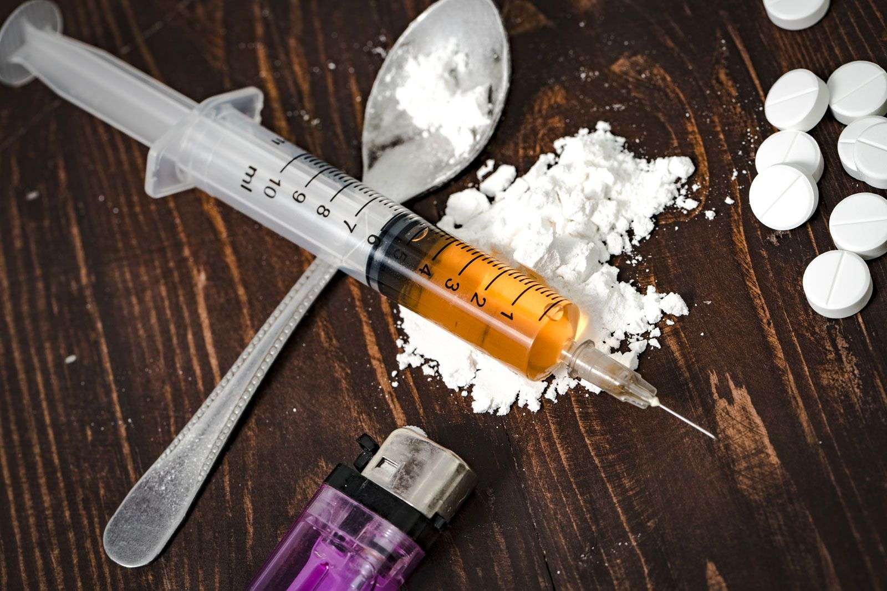


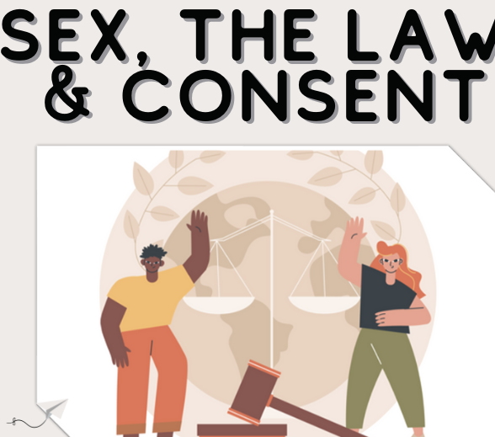
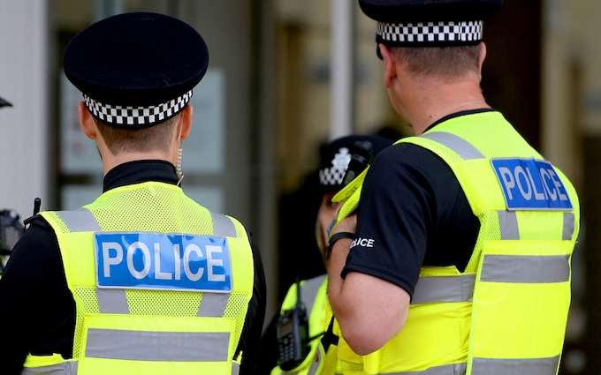
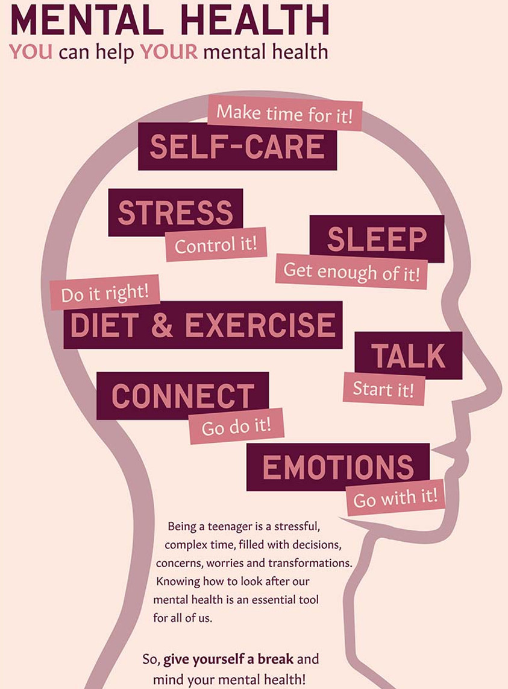
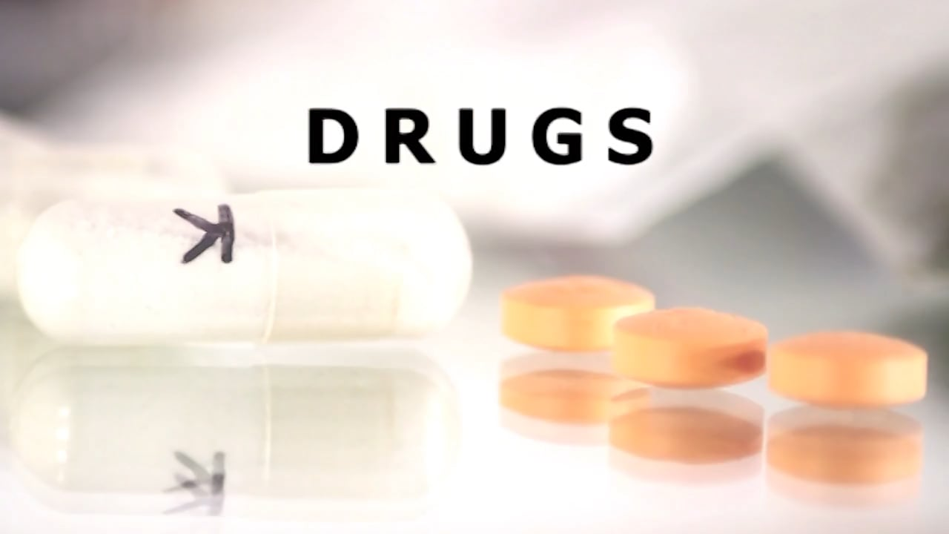


Beacon Hill Academy
Personal Development Programme
KS4 Learning Journey
Careers
Money & Budgeting
Higher Education
Further Education
Revision skills
Workplace skills
Growth Mindset
Banking
Post 16 pathways
Career Stereotypes
Impact of drugs on us in the work place and loss of income, promotion
CV writing
LMI
College taster days
Civil and Criminal Law
Quality of life and expectancy of dealing and using drugs
Professional users such as athletes
Vocational Qualities
Careers and Exam Prep
British Values
Issues of body image in the media & affect people's health
Moral and ethics & drugs - cheating ourselves, family and friends.
social problems affecting relationships
Tanning and Cancer
Managing loss, positive ways of dealing with it and where to get help
Personal safety
& Safer Sex
Exploitation in relationships
Concept of intolerance and racism including concept of shame and honour-based violence
Early signs of mental wellbeing - anxiety and depression
Unplanned
Pregnancy
When relationships go wrong - unhealthy and damaging
Health and Well Being Living in the Wider World
Organ and blood donation
Drugs as a way of life - dealers and suppliers.
Exploitation in relationships, Agencies that offer help and support
Expectations of a boyfriend and girlfriend
Career Identity applications
Confidentiality in workplace
Credit and Debit
Budgeting and managing money
Investment savings
ladder of drug use - physical, social, emotional and financial
Welcome to Year 11
Wages tax
Money stresses and pressure
Pensions
Relationships and Sex Educations and ESafety
Financial terms and products
Skills needed in workplace
Attitude and values in work
Borrowing money
Financial tools and services
Banking
How issues of body image affect people health
Interview techniques
manage feelings about, and influences on body image
Males and female differences about body image
Living In the wider world
health and personal emotional wellbeing.
Professional users such as athletes
Moral, ethics and drugs
British Values
County Lines
Media and body image,
Emotional wellbeing
Poverty and drugs
Talk from colleges and employers
poverty and drugs including mental health.
Marriage & Cultural differences
Help yourself and others in mental health and exercise
How the deflict model is used to sell things to us
consequences of substance use and misuse
Drugs as a way of life dealers and suppliers
Manage feelings about body image
Health and well being
Sexual Harassment
Things adults should think about before having a baby
Recognising, early signs of mental wellbeing
Managing mental health
Protection safety and minimising harm
Intolerance and racism
Impact of poor diet
Recognising stress and stressors
Mental health and exercise
Substance and health and personal information and well being
Support for teenage pregnanacy
Relationships and Sex Educations and ESafety
British Values
The age of consent contraception
Responsibility in relationships
Legal support for Unhealthy relationships.
Radicalisation and extremism
Online Safety
Factors of safer sex
Forced marriage & FGM
Welcome to Year 10
College Applications
College Courses
College courses
Teenage pregnancy
Different types of relationships
Damaging unhealthy relationships
Social problems that contribute to forced relationships

