Slide 1


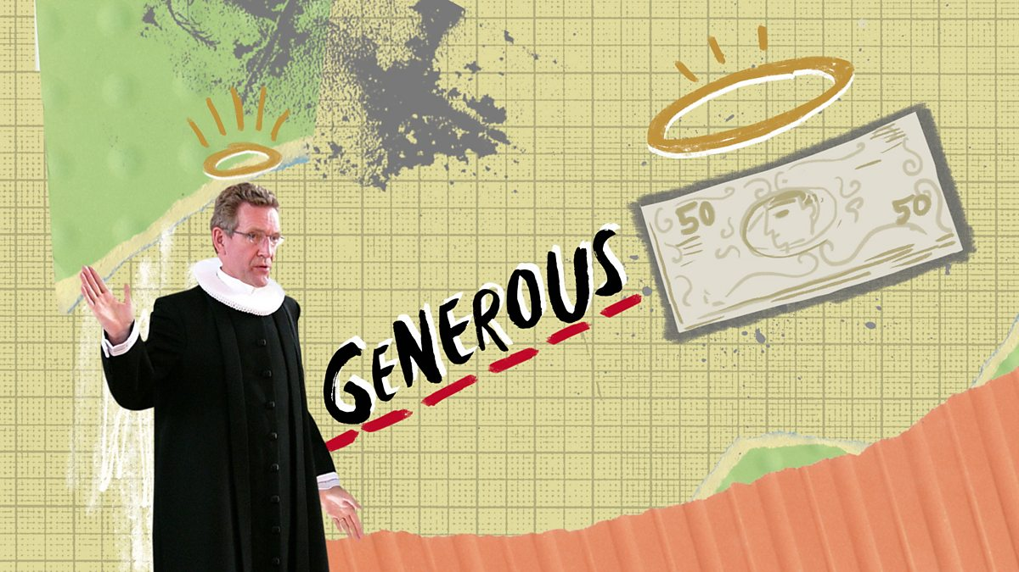


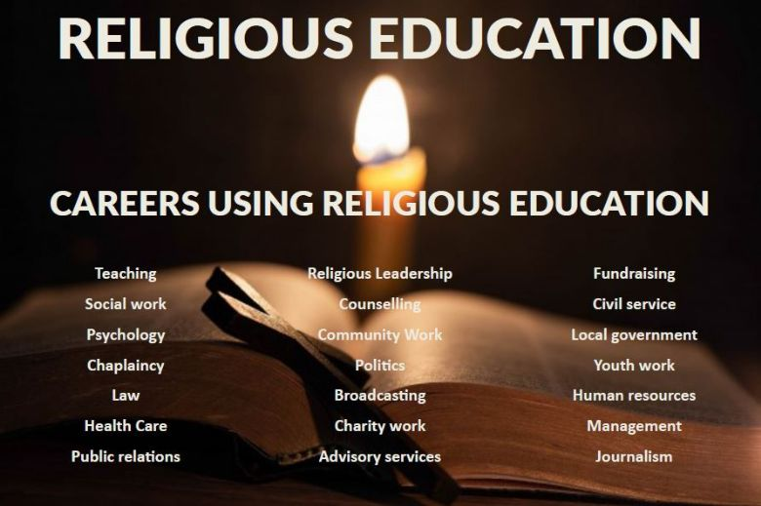
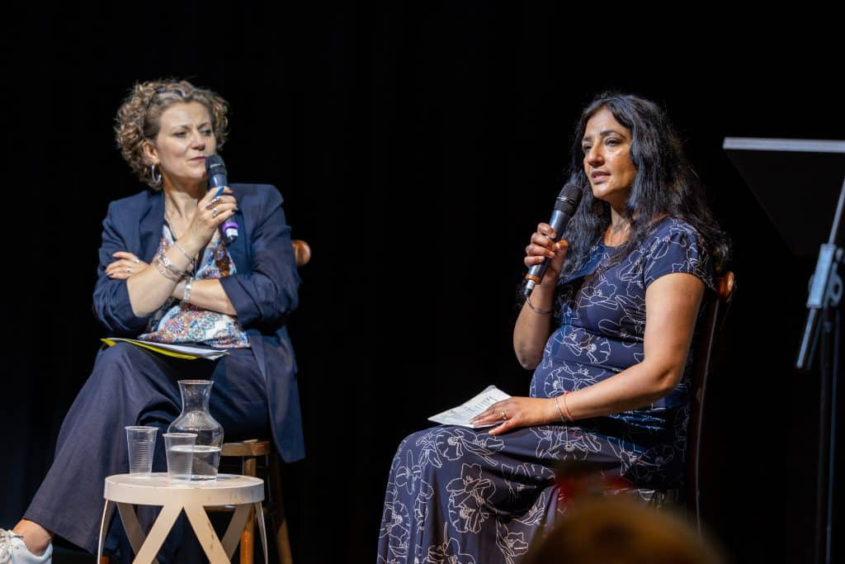

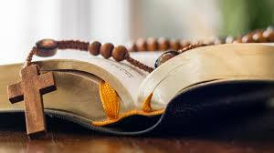
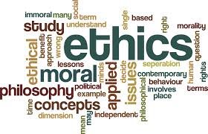




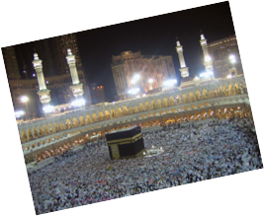
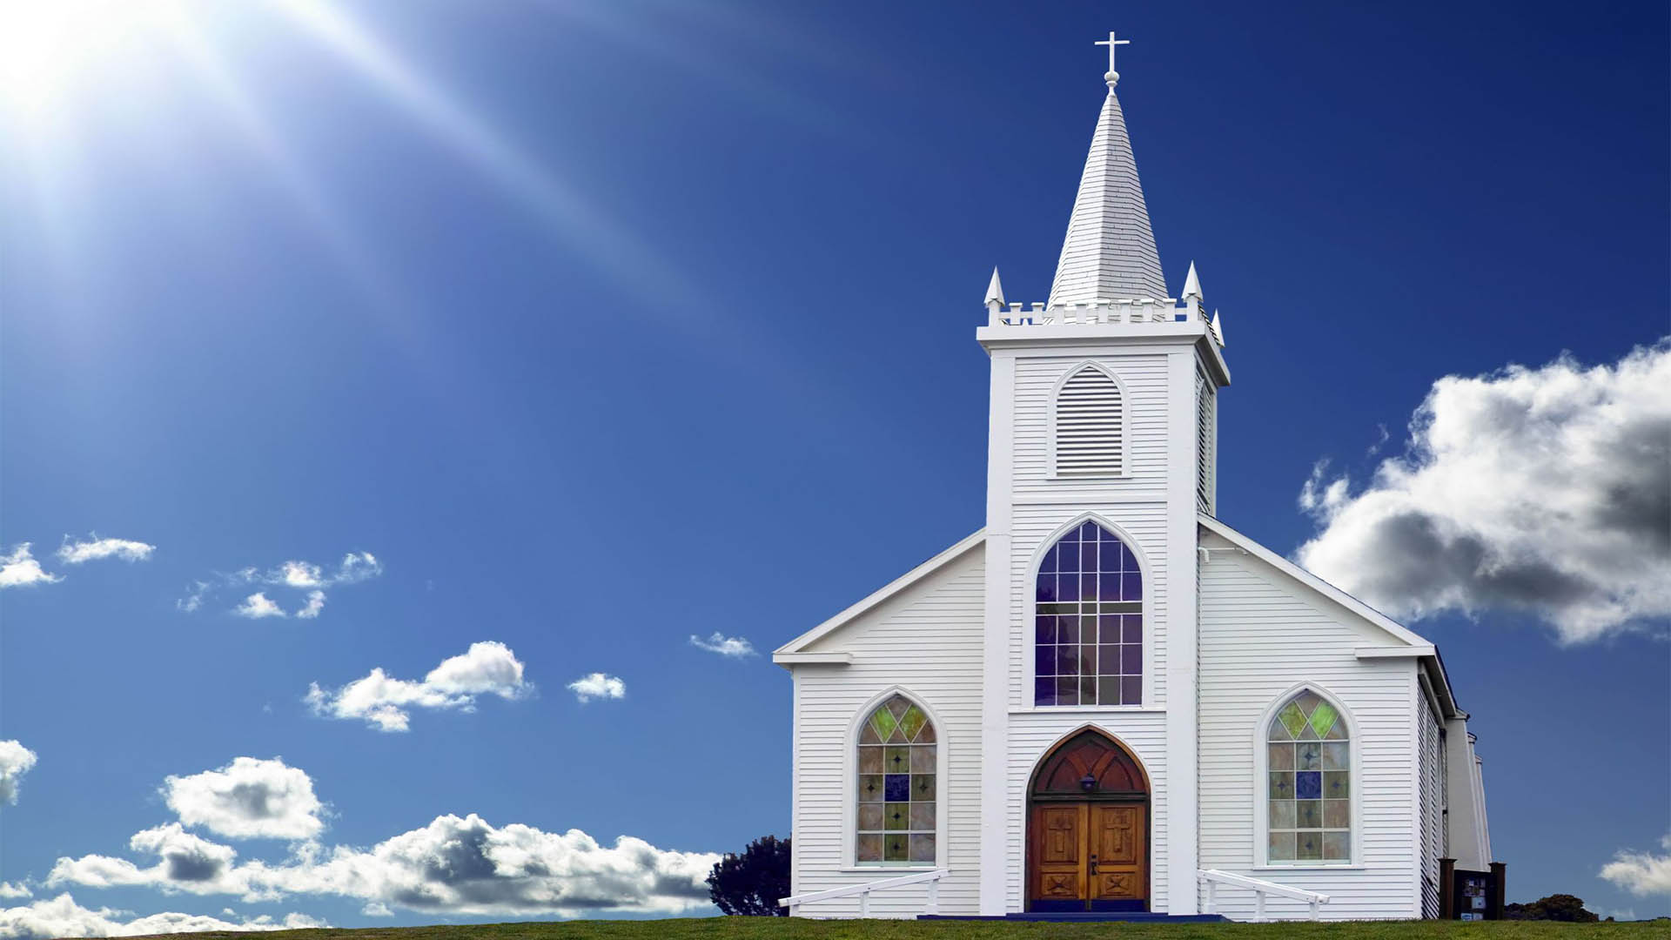

Empathy
Debate
Critical thinking skills
Reasoning
Communication skills
Confidence
Listening skills
Beacon Hill Academy
Religious Studies
Learning Journey
Religion, wealth and poverty
Welcome to Year 11
Religion: A Cause of War or a Means of Peace?
Careers in religion: Chaplin/Clergy, Politics, Medicine, Journalism, International Aid worker etc
Welcome to Year 11
Religion and relationships and families
Religion and Life
Do religious communities intend to make peace or war?
Welcome to Year 10
Religion – Conflict and peace
Jiha, media role in religious views
What did the Prophet Muhammad achieve as a peacemaker
What does Christianity teach and do about peace and conflict?
Religious views and ethics on animal testing
Religious views and ethics on capital punishment
Religious views and ethics on abortion
Religious views and ethics on hate crime
Religious views and ethics on Euthanasia
What does Ethical mean and do different religions have different ethics and morals
What makes Britian Multicultural; How has Britain benefited from multiculturalism; Potential problems with multiculturalism
Welcome to Year 9
Multicultural food, fashion, music, sport
Religion prejudice and discrimination
Religion and Ethics
What are the challenges of multiculturalism
Understand important features of Hajj
Pilgrimage
Welcome to Year 8
What is Multiculturalism
Why is Pilgrimage important to religion
Do all religions have same rules
Welcome to Year 7
Introduction to Religion; what is belief
Religious Customs
Islam
Buddhism
Hinduism
Different places of worships
Sikhism
Christianity

